Slide 1
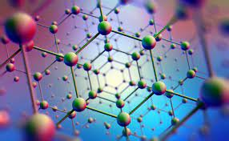
Nano-Technology
2011051-Farin Nowshin
2011052-Saiful Islam Nadim
2011054-Jihan Mahbub Khan
2011055- Mehrab Rahman
2011053- Md. Atik Faisal

Slide 2
What is Nano-tech?
Nanotechnology refers to the branch of science and engineering devoted to designing, producing, and using structures, devices, and systems by manipulating atoms and molecules at nanoscale, i.e. having one or more dimensions of the order of 100 nanometres (100 millionth of a millimetre) or less. It is also the use of matter on an atomic, molecular, and supramolecular scale for industrial purposes.

Slide 3
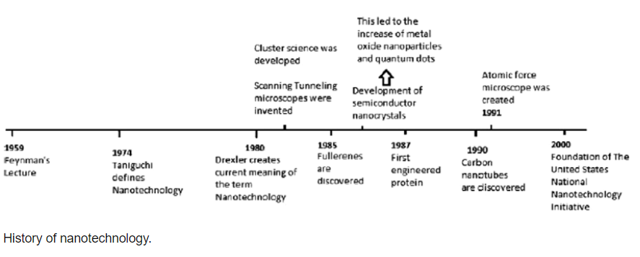
History of Nano-Technology

Slide 4
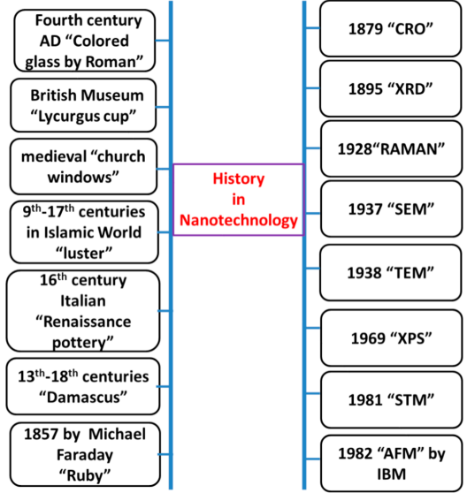

Slide 5
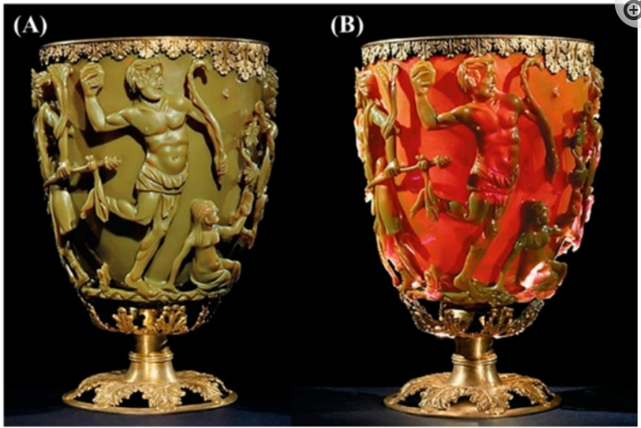
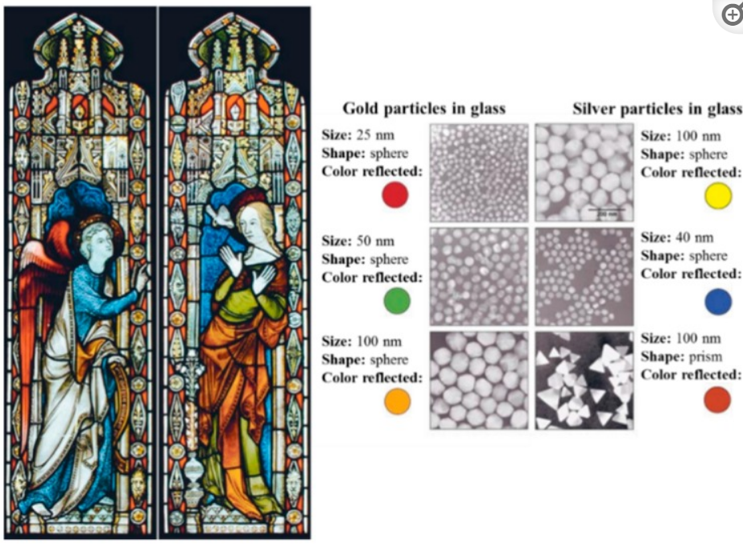
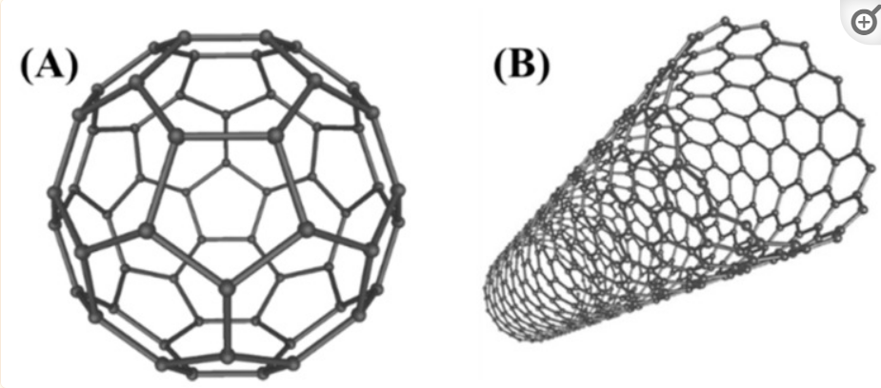
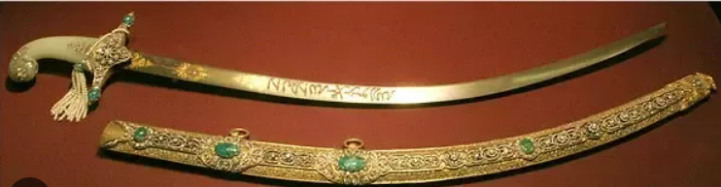
The Lycargus Cup
Color stained glass
Bucky ball & Carbon Tube
Damascus Steel

Slide 6
Nano-Technology Synthesis Processes
There are two types of nano technology or nano material synthesis processes.
Top-down method
Bottom-up method

Slide 7
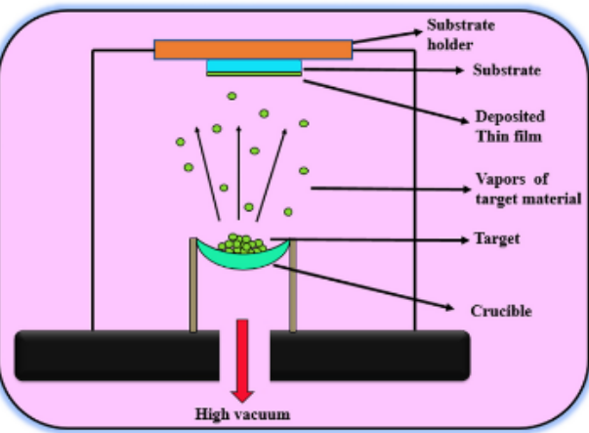
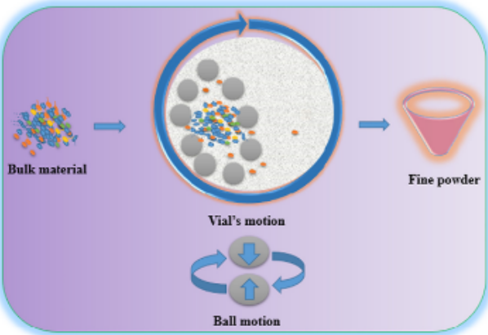
Top-Down
Top-down approach involves the breaking down of the bulk material into nanosized structures or particles. Top-down synthesis techniques are extension of those that have been used for producing micron sized particles.
Thermal Evaporation
Mechanical Milling

Slide 8
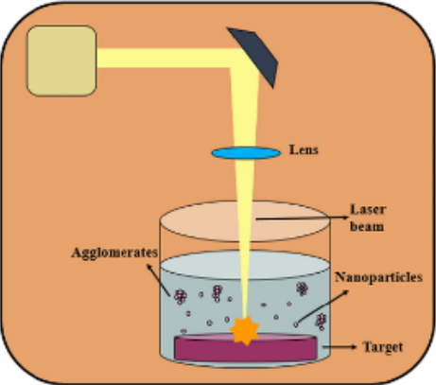
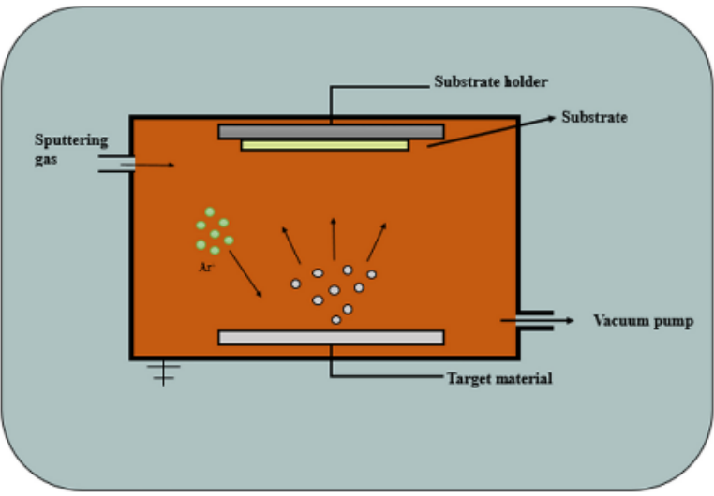
Laser Ablation
Sputtering

Slide 9
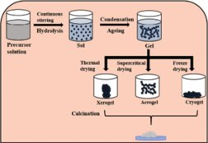
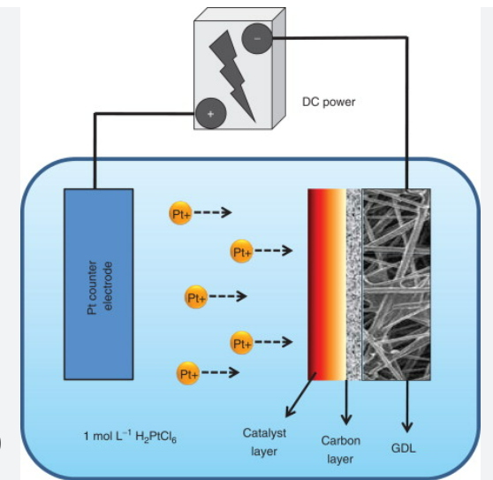
Bottom-Up Method
Sol-Gel Method
In general, bottom-up approach is meant by synthesis of nanoparticles by means of chemical reactions among the atoms/ions/molecules.
Eletro-deposition

Slide 10
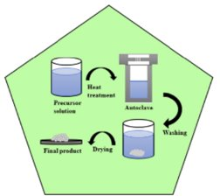
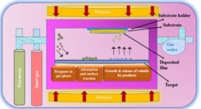
CVD
Hydrothermal Technique

Slide 11
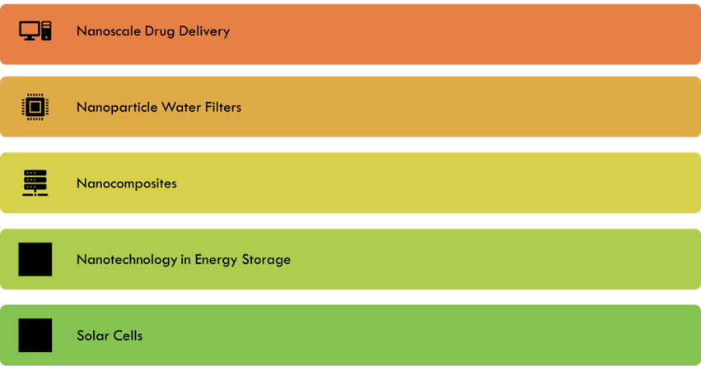
Five Examples of Nano-Technology

Slide 12
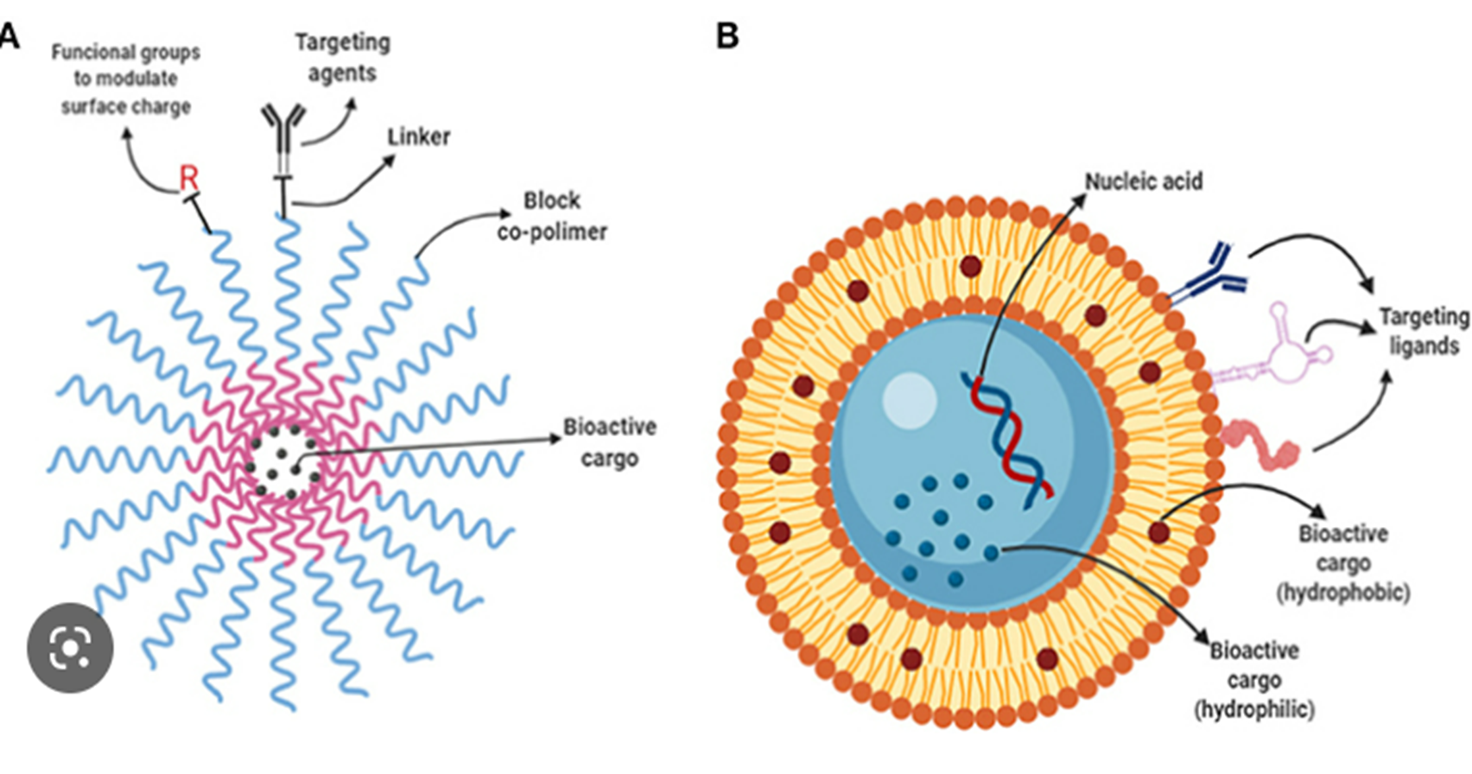
Nanoscale Drug Delivery

Slide 13
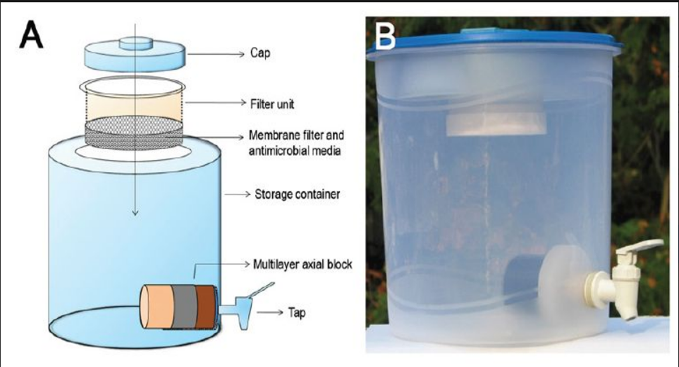
Nanoparticle Water Filter

Slide 14
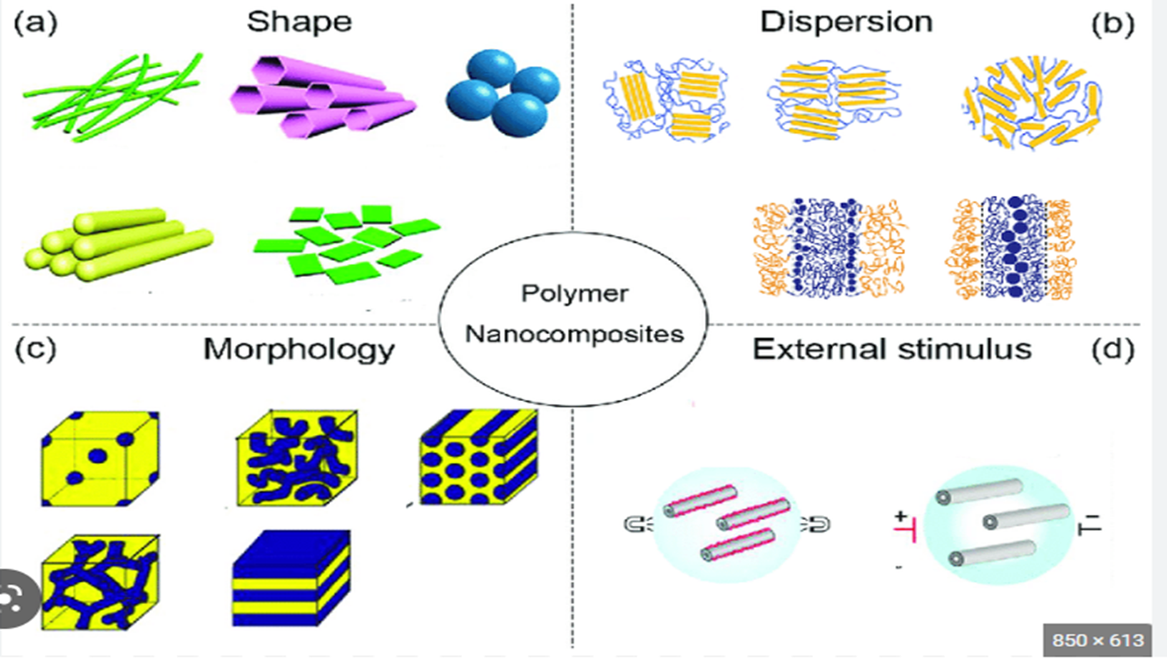
Nanocomposites

Slide 15
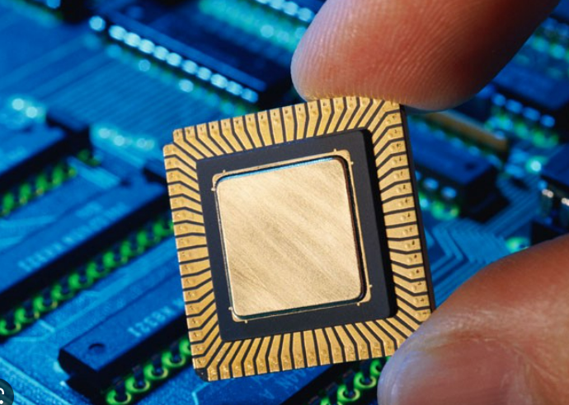
Nanotech in Electric Devices

Slide 16
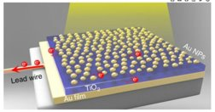
Nanotech In Solar Panels

Slide 17
A Significant Change in Electronic Goods
Enhanced medical Field work
Benefits for manufacturing
Energy production
Curing illness to a large extent
Developing computing & electronics
Coatings made of Nanoparticles
Easily accessible
Nanotechnology Advantages

Slide 18
Nanotechnology Disadvantages
Negative environment impact
Decrease in employment
Economic imbalance
Health Problems
Weapons that are dangerous and easily accessible
Costly
Negative effect on health
Risky
Fall of certain markets
Practical problems

Slide 19
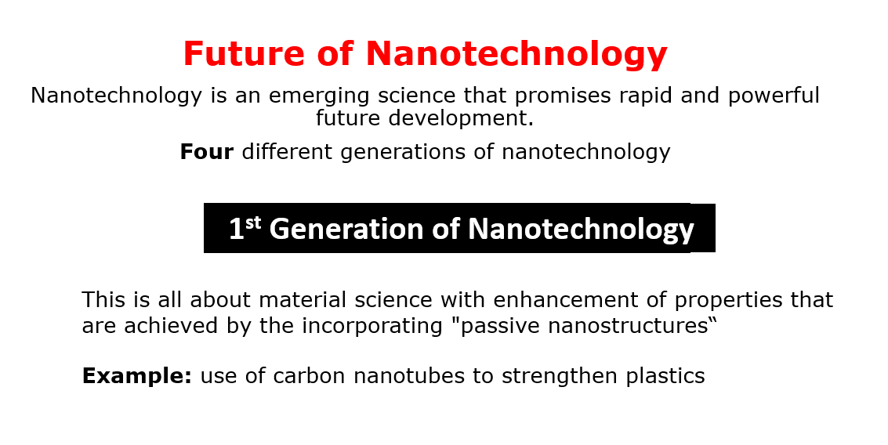

Slide 20
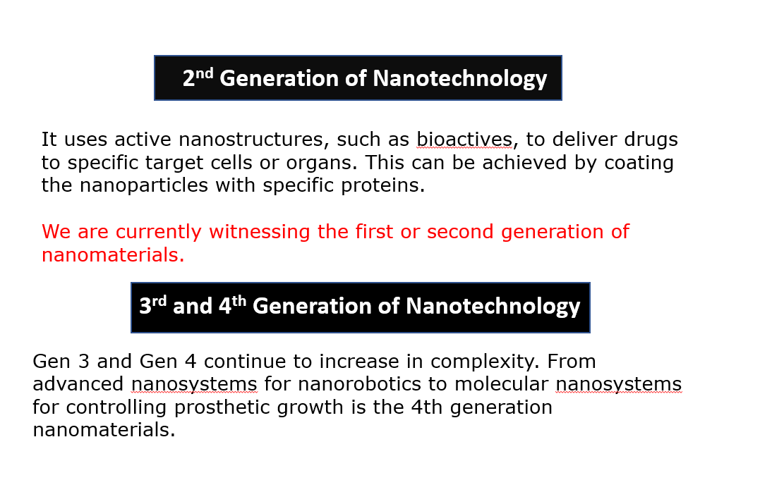

Slide 21
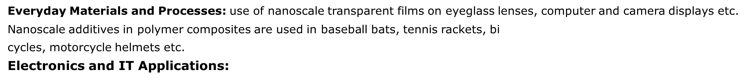
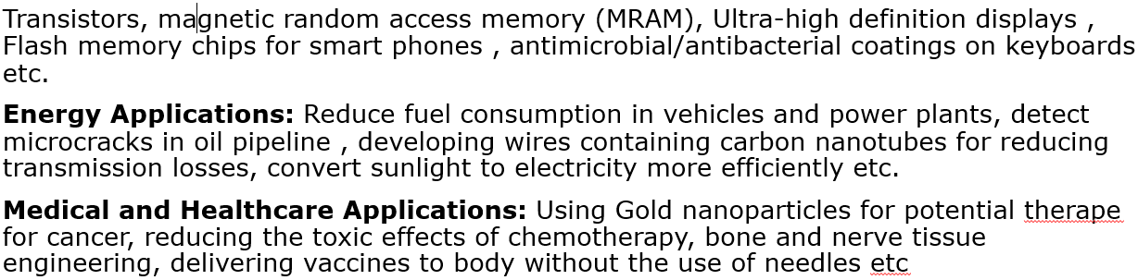
Demands of Nanotechnology

Slide 22
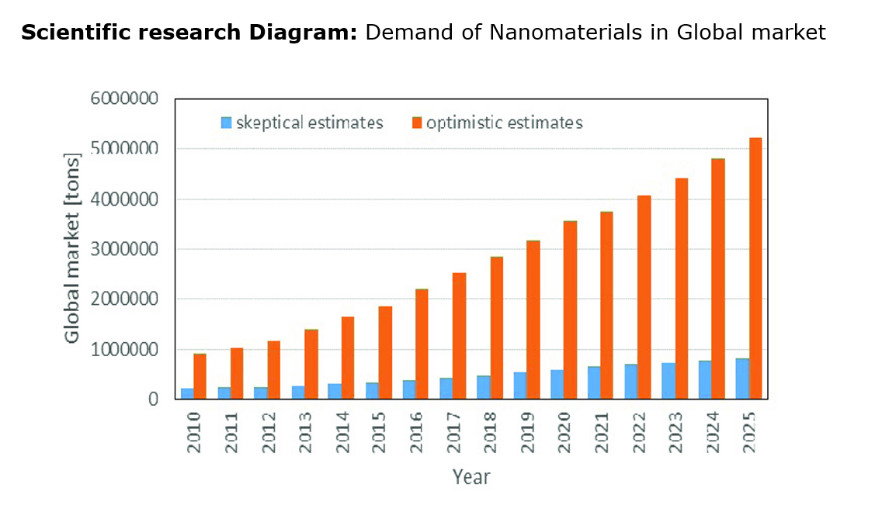

Slide 23
Thank you

